Slide 1
The decorator pattern… nothing but a hamburger.
Notes:
Today we are going to tell you something about the Decorator pattern. In order to clarify this pattern to you, we’ll go through a case with you. Imagine you want to start a new McDonalds, which creates hamburgers…

Slide 2
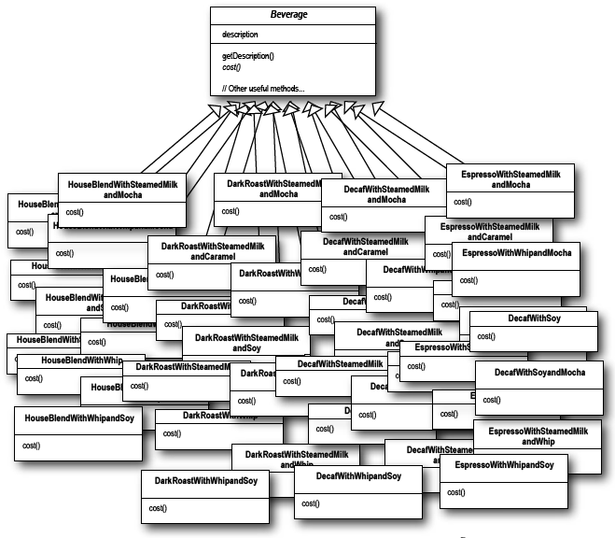
Problems!
Notes:
…will you create a new class for each of your hamburgers?

Slide 3
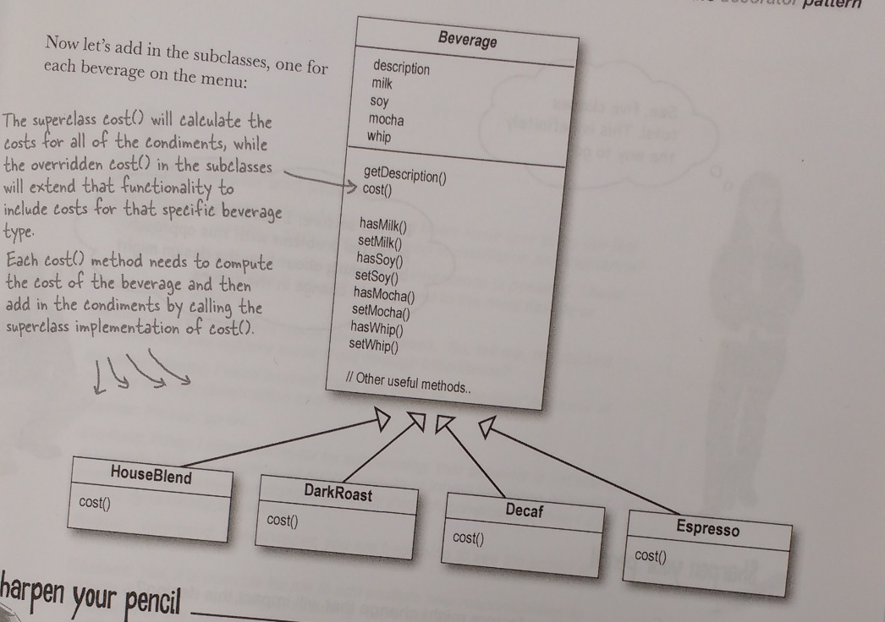
More problems…
Notes:
…will you create a single hamburgerclass with lots of Booleans (hasKetchup, hasCheese, hasVeggies, ….) ?

Slide 4
The solution!
Burger burger3 = new RoyalCrispyBurger(); burger3 = new Onions(burger3); burger3 = new Pickles(burger3); burger3 = new Tomato(burger3); burger3 = new Bacon(burger3); System.out.println(burger3.getDescription() + "\t" + eur.format(burger3.cost()));
Notes:
Fortunately, there is the decorator.
-> For our decorator, everything starts with an abstract class ‘Hamburger’, who has a cost and a description
-> You can extend the Hamburger to create no matter which concrete Hamburger
-> Then you want toppings. We’ll make them using an abstract toppings class, which has a hamburger field, because we want to know which hamburger should be topped
-> now we make the concrete toppings, who also overwrite cost and description()
As you can see on our powerpoint, we can let the magic happen at runtime in our main class
Drawing -> circles (with arrows!) and class diagram

Slide 5
Component Abstract Class / Interface
someMethod()
ConcreteComponent Extension/Implementation
someMethod()
Abstract ComponentDecorator Extension/Implementation
Decorator1 - Extension
Private concreteComp;
someMethod() { concreteComp.someMethod() + newStuff; }
Decorator2 - Extension
Private concreteComp;
someMethod() { concreteComp.someMethod() + newStuff; }
Component concreteComponent = new ConcreteComponent();
concreteComponent = new Decorator1(concreteComponent);
concreteComponent = new Decorator2(concreteComponent);
concreteComponent.someMethod();
Notes:
Everything starts in an abstract class or interface, to which everything is connected
Secondly, we create some concrete components. Those were the hamburgers in our previous example
Now we want to give some extras to our ConcreteComponent /Hamburger. We tell each of our decorators to which concreteComponents they should be added

Slide 6
The Decorator Pattern
Give objects new responsibilities without changing underlying classes
Positive | Negative
Avoid overuse of inheritance
Possibility to extend at runtime More dynamic & flexible than subclasses
Open for extension but closed for modification | Can lead to unnecessary complexity
Notes:
Inheritance is used solely for polymorphism
More negative: not always possible to use in real projects + many classes with little functionality

Slide 7
The decorator pattern & the child allowance exercise
Child child = new Child(2, LocalDate.of(2000,6,18)); Calculator allowance = new Allowance(child); allowance = new DisabledCalculator(child, allowance); allowance = new UnemploymentCalculator(child, allowance); System.out.println(allowance.calculate(child));
Notes:
Class child : knows birthdate and number
Interface Calculator: has 1 method calculate(Child child)
We create an allowance object, which implements Calculator and hold the sum of all our calculations
We add different allowanceCalculators to it

